Slide 1


Slide 2
TEAM MEMBERS
PROJECT MENTOR
MR.ASIF AHMED
MS.ABHIRAMI R
MR.VEMURU NEERAJ KUMAR
MS.HARSHITA MISHRA
MS.NEHA A
MS.LAVANYA CHINTHAPATLA
MS.LALITA VISHT
MR.INDUPALLI SASI KIRAN
MS.ASMA LOBABA

Slide 3
What is a Hospitality Analytics?
Hospitality analytics projects focus on using data analysis to improve operations, enhance customer experiences, and boost revenue within the hospitality industry. These projects can involve various aspects like reservation analytics, customer satisfaction analysis, and revenue management optimization. The goal is to gain insights from data to make informed decisions and improve key performance indicators (KPIs). Improved revenue management and forecasting, Enhanced customer satisfaction and loyalty, Optimized resource allocation and reduced costs, Better understanding of customer behavior and preferences, and Data-driven decision-making and strategic planning.

Slide 4
Key Components of Hospitality Project
Total Income – 1709M
Total Bookings – 135K
Income that generated for 3 months i.e. May,June,July across 4 different states i.e. Banglore , Delhi, Hyderabad, Mumbai of Atliq group of Hotels.
Bookings that happend for 3 months i.e. May,June,July across 4 different states i.e. Banglore , Delhi, Hyderabad, Mumbai of Atliq group of Hotels.
Occupancy% - 57.8%
Cancellation% - 24.8%
Occupancy for 3 months i.e. May,June,July across 4 different states i.e. Banglore , Delhi, Hyderabad, Mumbai of Atliq group of Hotels.
Out of 100 Bookings 24.8 Bookings are being Cancelled across 4 different states i.e. Banglore , Delhi, Hyderabad, Mumbai for 3 months i.e. May,June,July of Atliq group of Hotels.

Slide 5
KPI LIST
Total Revenue
Total Booking
Occupancy%
Cancellation%
Revenue By State & Hotel
Booking Status
Revenue By Booking Platform
Revenue & Booking Count By Weekend Or Weekday
Class Wise Revenue
Revenue & Occupancy By Week
Trend Analysis

Slide 6
SUMMARY OF THE PROJECT
The analysis shows total revenue of 1709 M across states, with total booking of 135k,total occupancy of 57.87% and cancellation rate of 24.83%.
Elite is having high revenue and standard has less revenue when it comes to class wise revenue .
Total count of bookings and total revenue for weekday is more compared to weekend.
May month is having high revenue when compared to June and July.
Mumbai has high revenue when compared to Bangalore, Hyderabad and Delhi.
When it comes to revenue and occupancy by week,there is fluctuation from week to week.
There is a high cancellation rate which needs to be monitored .
Need to optimise weekend to increase occupancy and revenue

Slide 7
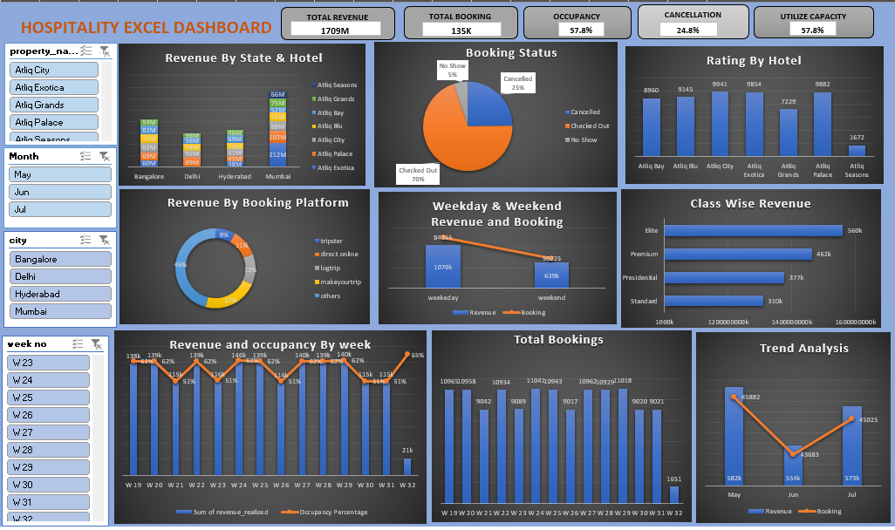
EXCEL DASHBOARD

Slide 8
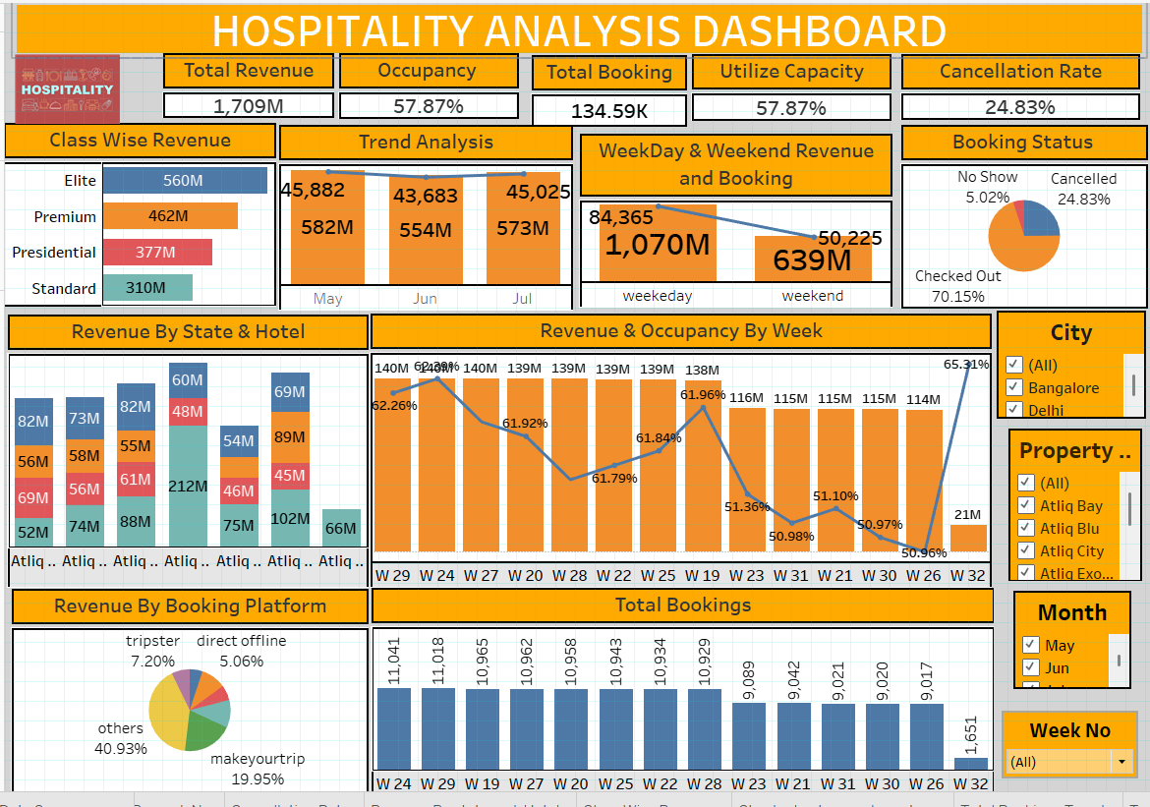
TABLEAU DASHBOARD

Slide 9
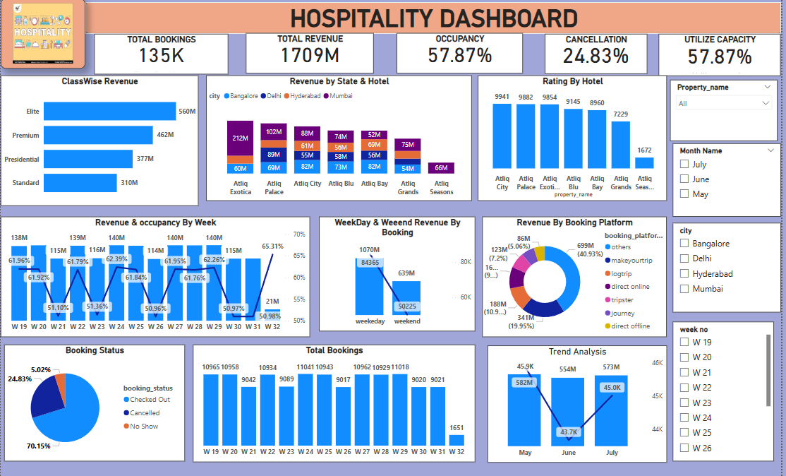
POWER BI DASHBOARD

Slide 10
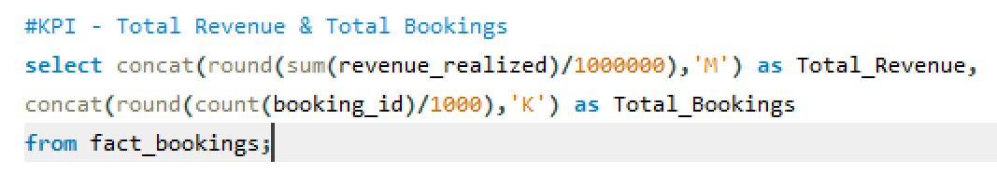
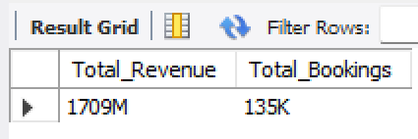
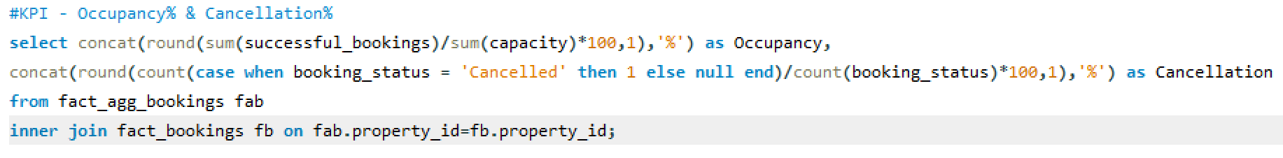
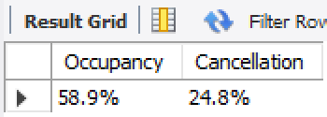
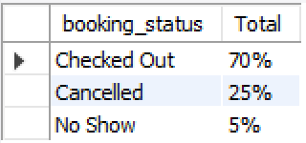
SQL QUERIES

Slide 11
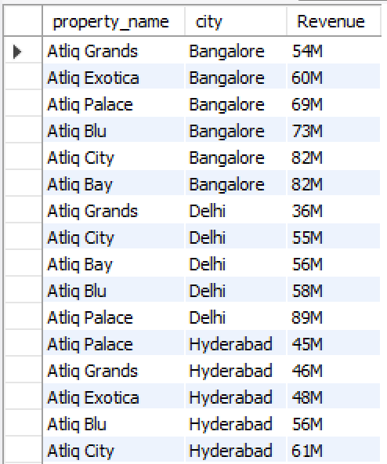
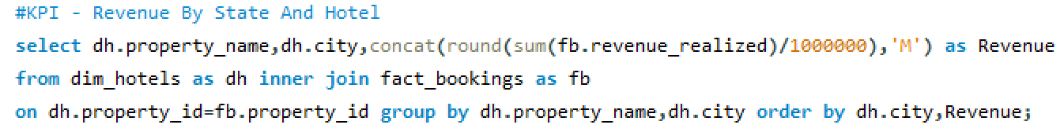
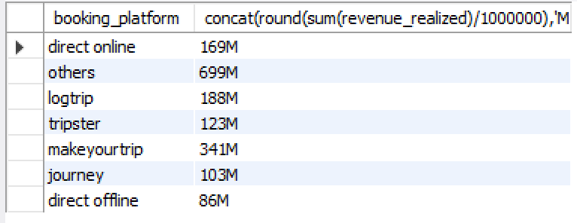
SQL QUERIES

Slide 12
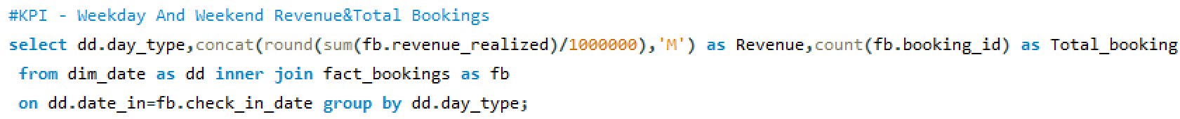

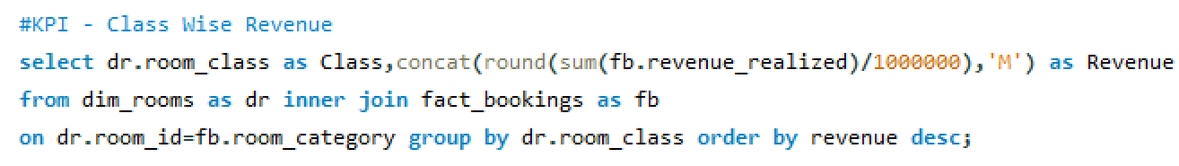
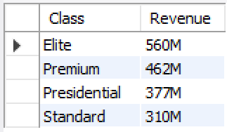
SQL QUERIES

Slide 13
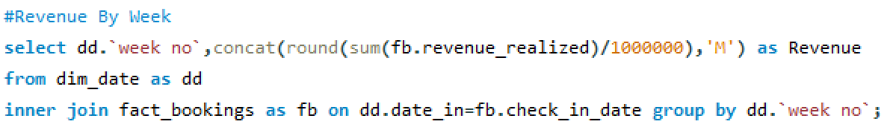
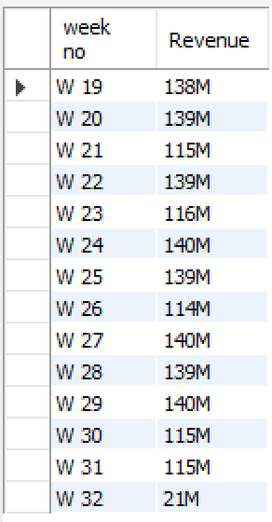
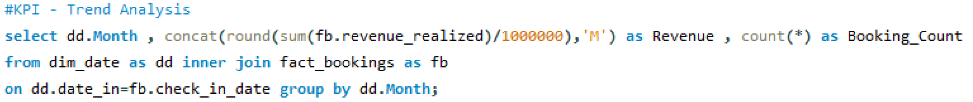
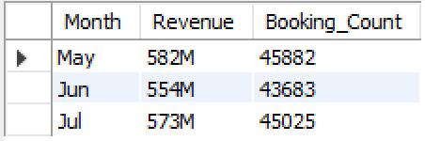
SQL QUERIES

Slide 14
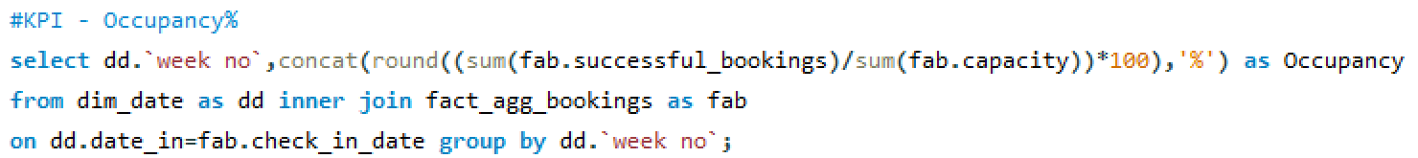
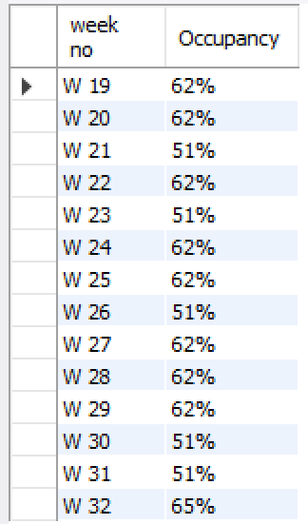
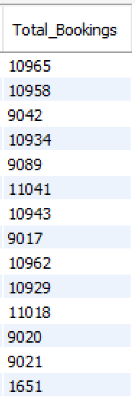
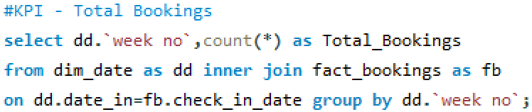
SQL QUERIES

Slide 15
CHALLENGES FACED
Data-Related Challenges
Data Cleaning & Transformation
Data Connectivity Issues
Handling Large Datasets
Data Modeling Challenges
Defining Relationships
Complex DAX Calculations
Visualization & Dashboard Challenges
Choosing the Right Visuals
Interactivity Issues
SQL Queries

Slide 16
CONCLUSION
In conclusion, data analytics offers significant benefits for the hospitality industry, enabling businesses to make more informed decisions, enhance guest experiences, and ultimately improve profitability. By leveraging data, hoteliers can optimize various aspects of their operations, from forecasting demand and pricing to managing staffing and inventory
In summary, data analytics is not just a trend in the hospitality industry; it's a critical tool for staying competitive and successful in an increasingly data-driven world. By embracing data analytics, hotels can unlock valuable insights, improve operations, enhance guest experiences, and drive revenue growth. . This leads to increased revenue, reduced costs, and a more personalized and satisfying customer experience.

Slide 17
Thank You

